Slide 1

Crop Yield Prediction and Fertilizer Analysis Using Machine Learning Algorithm
by
D.Venkata Naresh
Roll No. 194G5A0510
D.Varsha
Roll No. 184G1A05A8
P.Suchitha
Roll No. 184G1A0598
Y.Sreelakshmi
Roll No. 184G1A0596
Under the guidance of
Mr.Sreedhar B M.Tech,MBA
Assistant Professor
Department of Computer Science and Engineering
Srinivasa Ramanujan Institute of Technology
(Affiliated to JNTUA & Approved by AICTE) (Accredited by NAAC with ‘A’ Grade & Accredited by NBA (EEE, ECE & CSE)
Rotarypuram Village, B K Samudram Mandal, Ananthapuramu – 515701.
2021 - 2022

Slide 2
Review-0 Remarks
Scope of the project?
To predict the crop yield and suggest the suitable fertilizer to the crop at the early stages.
What is dataset ?
A Dataset is a collection of data. In Machine Learning projects we need a training dataset. It is a actual dataset used to train the model for performing various actions.
What are different types of Datasets used?
Fertilizer Dataset, Crop Yield Dataset.
Are u training on only one soil or different type of soils ?
Different types of soils like black soil, red soil
What is Regression?
It is a technique used to model and analyze the relationships between variables.
What is SVM?
SVM is a Supervised Learning algorithm used for Classification and Regression.

Slide 3
Review-1 Remarks
What are the different stages of crop?
Seed stage
Young plant
Mature plant stage
Flowering stage
Fruit stage.
How do you merge two datasets?
Using pandas library and merge() method[having one common feature in both datasets].
Scope of the project?
To predict the crop yield and suggest the fertilizer to the crop at the Mature Plant Stage.
What locations you will consider from dataset?
India location is to be considered from the dataset.
What inputs you will consider?
The inputs are weather, humidity, location and nutrients of soil.

Slide 4
Review 2 Remarks
Is stages of crops is same for all crops?
No, we categorized it as 5 stages and applied at Mature stage plant.
Limitation of the Project?
Only 5 types of soils are considered, and is applied only at mature stage of the plant.
How Random Forest algorithm works?
Random Forest algorithm builds a forest in the form of an ensemble of decision trees which adds more randomness while growing the trees. While splitting a node ,the algorithm searches for the best features from the random subset of features which adds more diversity, thereby resulting in a better model.
How many Decision trees will be considering ?
We can construct any number of trees based on the features of the Dataset and considering the depth of Decision tree.

Slide 5
Contd…
What are Cleaning Techniques?
Removal of Unwanted Observations
Fixing Structural errors
Managing unwanted outliers
Handling missing Data
What are outputs of Random Forest algorithm?
Each decision tree gives a output, and takes majority votes in case of Classification and average in case of Regression problems.

Slide 6
Abstract
This project will help the farmers to know the suitable fertilizers and to predict the crop yield.
It attempts to suggest by building a model using Machine Learning Algorithms.
Machine Learning is an essential approach for achieving practical and effective solutions for this problem.
We plan to predict the crop yield using Machine Learning Algorithm like Random Forest Algorithm.
To analyze Crop Yield Accuracy by differentiating the Dataset into trained dataset and test dataset.

Slide 7

Contents
Introduction
Existing System
Proposed System
Literature Survey
Problem Definition
Planning of the project
Requirements to Develop/Implement the project
UML Diagrams
Output screenshots
Conclusion
References

Slide 8
Introduction
Crop yield is an important agricultural problem.
Every farmer always tries to know how much yield will be produced and whether it meets their expectations.
In the past, yield prediction was calculated by analysing a farmer’s previous experience on a particular crop.
The aim of this project is to suggest the right fertilizer to get the better yield and to predict the yield of the crop.

Slide 9
Existing System
There was an existing model on Crop recommendation System.
By considering the season and type of soil,existed system used to recommend the crop.
The existing model proved an efficency of detecting the crop prediction of 75.8%.

Slide 10
Proposed System
The proposed system uses the machine learning algorithms to suggest the fertilizers and to predict the crop yield.
Acknowledge the farmers what fertilizers can be used for crop to get better yield.
The factors like temperature,humidity,moisture,crop type ,soil type etc are considered.
By creating an web interface ,we take these factors as input and suggest fertilizers.
The existing dataset is trained by using machine learning algorithms like Random forest algorithm.

Slide 11
Literature Survey
[Rushika Ghadge1, Juilee Kulkarni2, Pooja More3, Sachee Nene4, Priya R L5(Feb-2018)] used Multiple Linear Regression technique for crop analysis.Back Propagation Network to evaluate the test data set and to predict soil properties with parameters.SVM is used to show the effectiveness in soil quality prediction and to increase the accuracy.Back Propagation Algorithm is used to check for Soil Fertility and Plant nutrient.
[ Niketa Gandhi,Leisa J. Armstrong,Owaiz Petkar ,Amiya Kumar Tripathy(2016 IEEE)] They mainly focused on one crop i.e.,Rice by using one machine learning algorithm (SVM).SVM is used to forecast the response patterns on climatic conditions and providing features contribution analysis for agricultural yield prediction.It creates functions from a set of training data.For performance evaluation they used confusion matrix.

Slide 12
Contd...
[Arun Kumar1, Naveen Kumar2, Vishal Vats3(June-2018)] In this paper three supervised techniques are used like as K-Nearest Neighbor, Support Vector Machine and LS-SVM to train and build a model. This work is basically provides the comparative study of various algorithm when we apply these algorithm on datasets and it shows the accuracy of each algorithms to train the datasets and among these three Least Squared Support Vector Machine shown high Accuracy.

Slide 13
Problem Definition
The works done till now are only concentrated on crop prediction using different soil properties and Data Mining Techniques. Fertilizer Analysis is not taken into much consideration.
So it is necessary to develop crop yield prediction and fertilizer Analysis system which predicts crop yield based on soil nutrients .
Crop yield and Fertilizer Analysis for selected crop based on different datasets like fertilizer dataset and Crop yield dataset.

Slide 14
Planning of the Project
WEEKS | TASK
WEEK1 | Downloading and installing required softwares
WEEK2 | Analysing the dataset
WEEK3 | Develop a model
WEEK4 | Test the model
WEEK5 | Develop a webpage for our model

Slide 15
Requirements
SYSTEM SPECIFICATIONS:
H/W Specifications:
Processor :I3&above/Intel Processor
RAM :4GB
Hard Disk :128GB
S/W Specifications:
Operating System : Windows7+
Server side Script :Python 3.8
IDE :Visual studio code, Jupyter notebook
Libraries :Numpy, Pandas, Sklearn, streamlit.

Slide 16
System Architecture
Crop yield data
Crop Yield Prediction
Machine learning algorithm
Random Forest
Inputs: Crop Yield data set , fertilizer data set.
Output: Crop Yield, Fertilizer
Fertilizer data
Fertilizer Suggestion

Slide 17
UML- Activity Diagram
Dataset
Activity
Control Flow
Data preprocessing
Feature Extraction
Start/stop
Train Model
Test Model
Fertilizer Analysis Model
Prediction of crop yield
Suitable Fertilizer
Crop yield

Slide 18
Implementation
Crop Yield Prediction:
Crop Yield Prediction can be done using crop yield data, nutrients and location data. These inputs are passed to Random Forest algorithm. These algorithms will predict crop based on present inputs.
Fertilizer Analysis:
Fertilizer Analysis can be done using fertilizer data , crop and location data. In this part suitable crops and required fertilizer for each crop is suggested.

Slide 19
Random Forest Algorithm
Random Forest is a popular Machine Learning algorithm that belongs to the supervised learning technique. It can be used for both classification and Regression problems in Machine Learning.
It is based on the concept of ensemble learning, which is a process of combining multiple classifiers to solve a complex problem and to improve the performance of the problem.
As the name suggests, “Random Forest is a classifier that contains a number of decision trees on various subsets of the given dataset and takes the average to improve the predictive accuracy of that dataset.”
The greatest number of trees in the forest leads to higher accuracy and prevents the problem of overfitting.

Slide 20
Contd...
Working of Random Forest algorithm
Decision tree 1
output 1
Data set
Decision tree 2
output 2
output1
Decision tree 3
output 1

Slide 21
Sample code
Reading data from dataset
# Load the Pandas libraries with alias 'pd'
import pandas as pd
Read data from file 'filename.csv'
# (in the same directory that your python process is based)
# Control delimiters, rows, column names with read_csv
data = pd.read_csv("filename.csv")
# Preview the first 5 lines of the loaded data
data.head()

Slide 22
contd…
from sklearn.ensemble import RandomForestClassifier
rf_random = RandomForestClassifier()
rf_random.fit(X_train,y_train)
predictions = rf_random.predict(X_test)
Scikit-learn(sklearn) is the most useful and robust library for machine learning in python. It provides a selection of efficient tools for machine learning and statistical modeling including classification, regression, clustering and dimensionality reduction via a consistence interface in python.

Slide 23
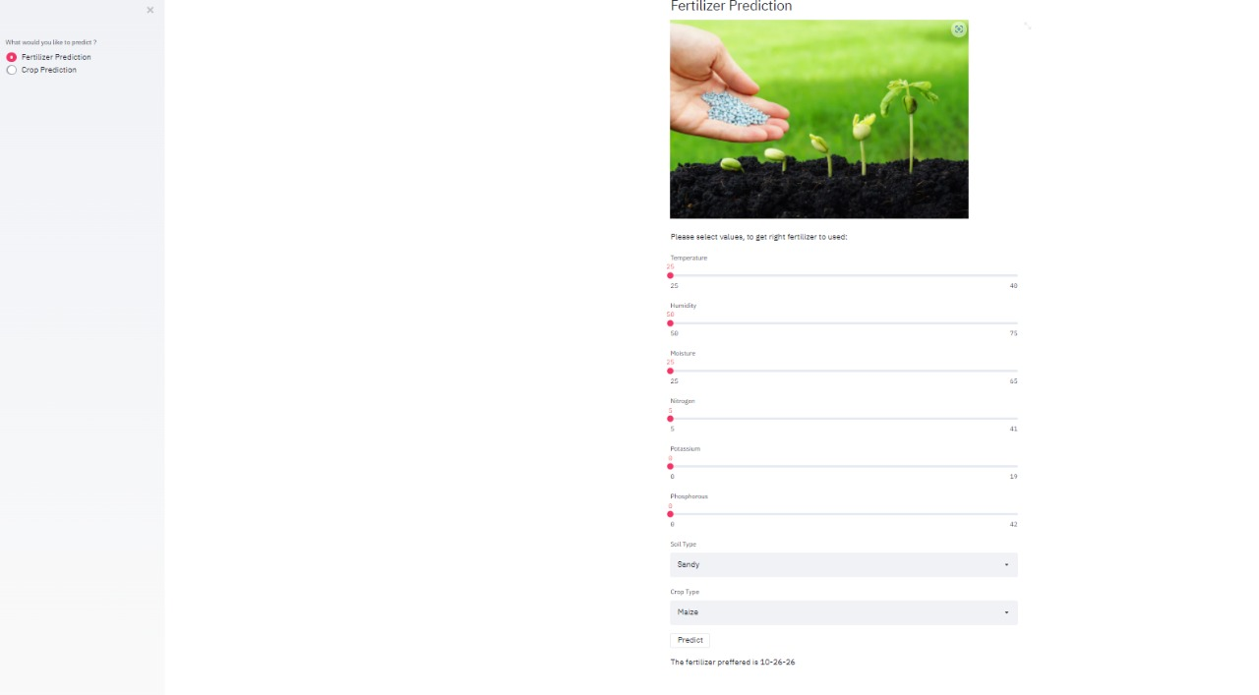
Outputs

Slide 24
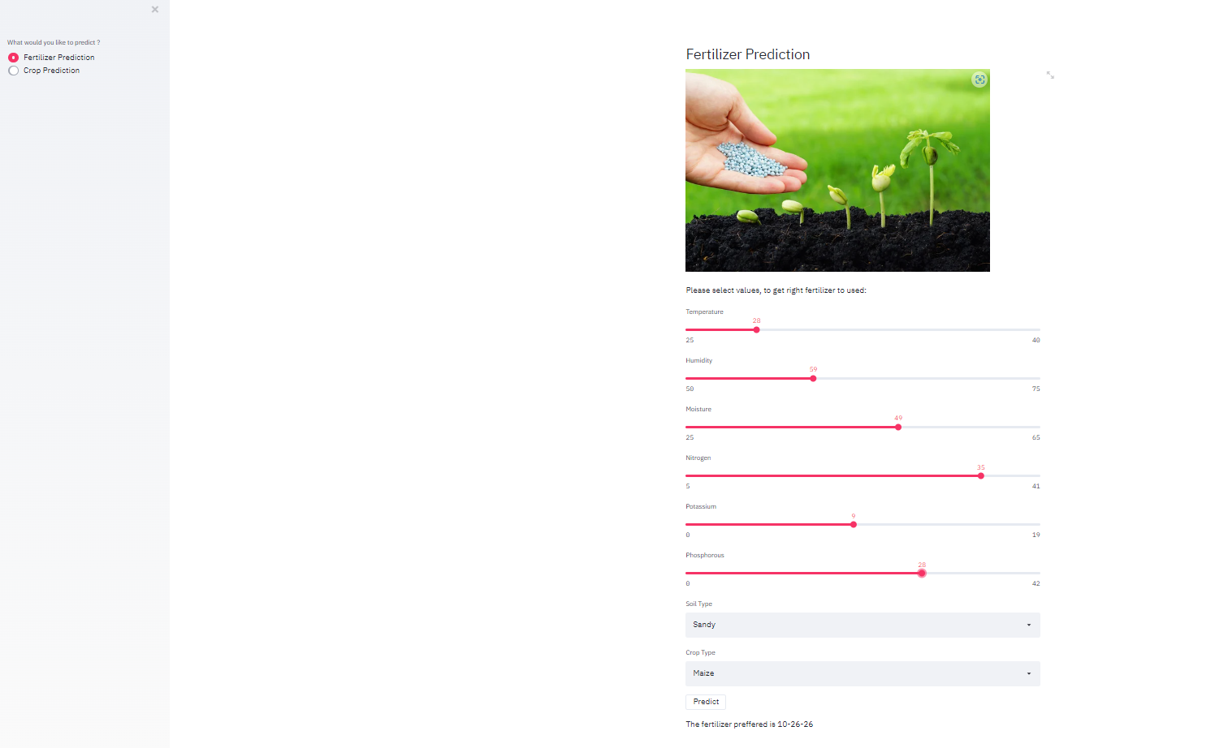
Contd…

Slide 25
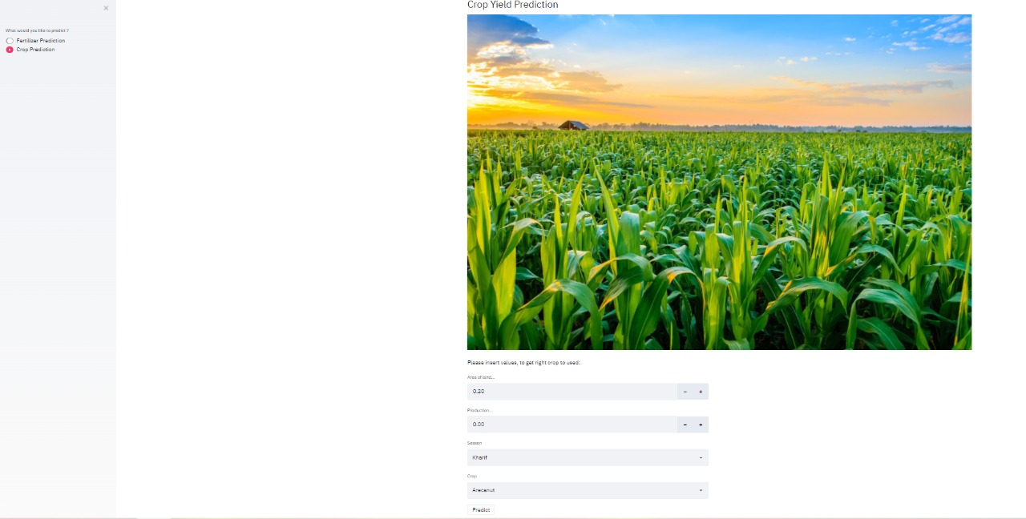
Outputs

Slide 26
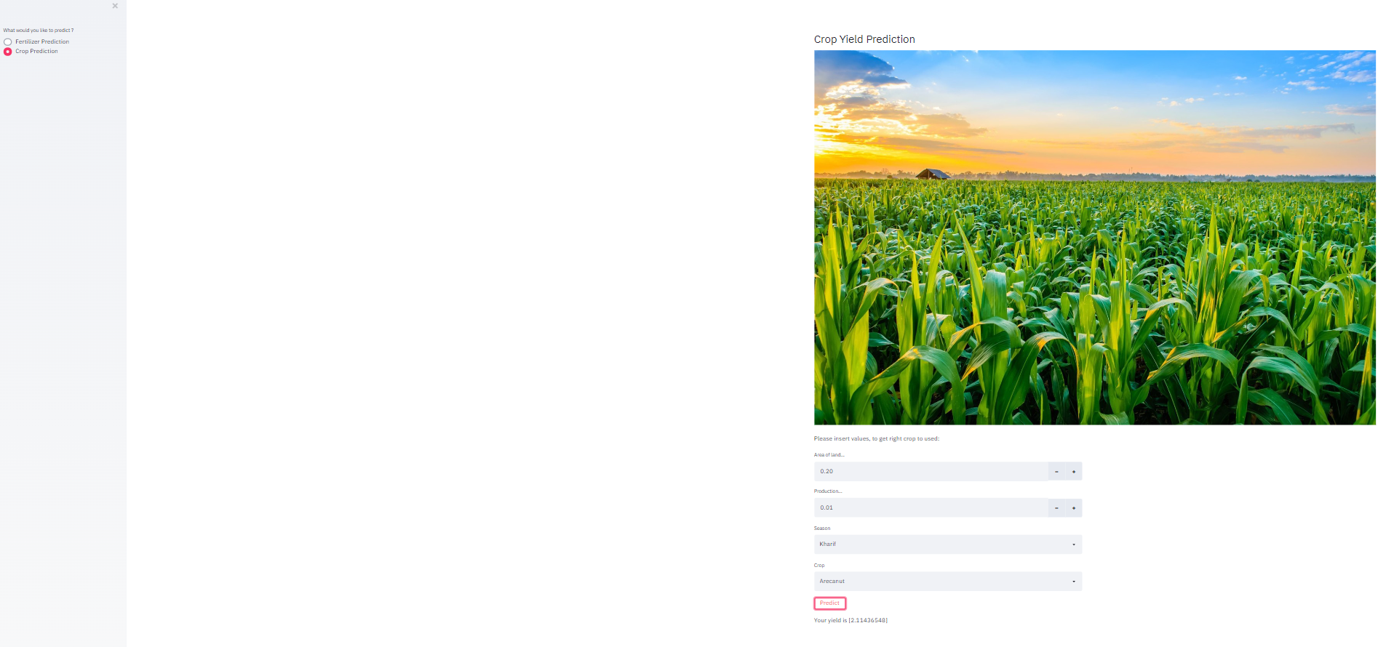
Contd…

Slide 27
Conclusion
The system of Predicting crop yield and fertilizer Analysis predicted crop yield and suggested suitable fertilizer for the crop.
The prediction of crop yield based on locations and datasets, and proper implementation of algorithms proved that the higher crop yield can be achieved.
From the work we conclude that crop yield is predicted with high accuracy of 95.1% using Random Forest algorithm and Fertilizer analysis is done with the accuracy of 96.7%.

Slide 28
Reference
[1] Rushika G., Juilee K, Pooja M, Sachee N, and PriyaR.L.(2018). Prediction of Crop Yield using Machine Learning, Issue 02 IRJET (pg 2337-2339).
[2] Niketa G, Leisa A.J., Owaiz Petkar, and Amiya K.T.(2016). Rice Crop Yield Prediction in India using Support Vector Machines 978-1-5090-2033-1/16/$31.00 ©2016 IEEE.
[3] Arun K, Navin K, and Vishal V (2018). Efficient Crop Yield Prediction using Machine Learning, (pp.3151-3159),IRJET.
[4] Potnuru Sai Nishant,Pinapa Sai Venkat,Bollu Lakshmi Avinash(2020) Crop Yield Prediction based on Indian Agriculture using Machine Learning.

Slide 29
Thank You!!!

